Slide 1
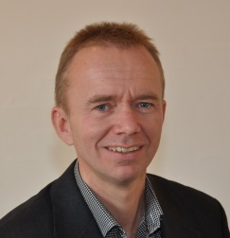
SOTA panel session, WCSMO11, June 11 2015
Design applications: success stories
and emerging opportunities
Erik Lund
Aalborg University, Denmark
The overview is mainly based on the 343 abstracts and 167 associated conference papers.
NB: Apologize in advance for any omission of a success story – it has not been ignored on purpose ☺
Aalborg University, Denmark
1
Department of Mechanical and Manufacturing Engineering

Slide 2
Optimization papers including “standard benchmark examples” (with main focus on development of methods) 1/2
More than 220 presentations in this category, and most are related to structural optimization (size, shape or topology) with focus on mechanical performance.
Some sub categories with other physics or specialized areas:
Heat transfer / fluid flow: 13
Wave propagation (ICT, Energy, cloaking devices, …)
  Acoustics/phononics: 12
  Photonics: 9
Electromagnetics: 7
Piezo-electricity / energy harvesting: 6
Electronics: 3
Design of actuators and sensors (not included above): 6
Fluid-structure interaction: 4
Other multiphysics interaction problems: 3
Aalborg University, Denmark
2
Department of Mechanical and Manufacturing Engineering

Slide 3
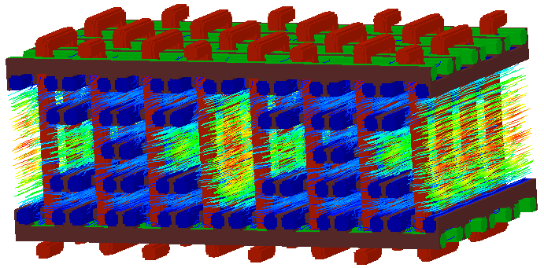
Optimization papers including “standard benchmark examples” (with main focus on development of methods) 2/2
More than 220 presentations in this category, and most are related to structural optimization (size, shape or topology) with focus on mechanical performance.
Some sub categories with other physics or specialized areas:
Design of microstructure: 16
Multi-scale: 14
Composites: 15
Design for Additive Manufacturing: 9
Other manufacturing constraints: 9
Stress constraints: 12
Fatigue constraints: 5
Seismic response control: 6
Robotics: 4
Machine elements: 3
Permeability = +120%
Mass = -20%
Stiffness = -15%
(Paper ID: 1353)
Aalborg University, Denmark
3
Department of Mechanical and Manufacturing Engineering

Slide 4
Success stories within transport – automotive 1/2
24 presentations with the following subtopics:
Vehicle design (paper ID: 1007, 1059, 1196, 1203, 1365, 1440)
Automotive components (1037, 1074, 1146, 1149, 1178, 1191, 1215, 1258, 1356, 1357, 1398, 1401)
Aalborg University, Denmark
4
Department of Mechanical and Manufacturing Engineering

Slide 5
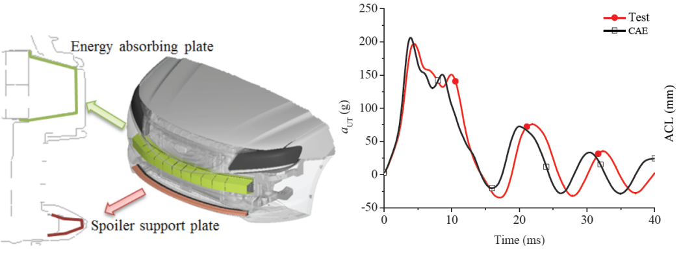
Success stories within transport – automotive 2/2
24 presentations with the following subtopics:
Crash optimization (1033, 1036, 1049, 1114)
Occupant safety / airbags (1134)
Pedestrian considerations (1455)
Aalborg University, Denmark
5
Department of Mechanical and Manufacturing Engineering

Slide 6
Success stories within transport – others
3 presentations with the following subtopics:
Trains (1037)
Ships (1129)
Wheelchair – comfort (1451)
Aalborg University, Denmark
6
Department of Mechanical and Manufacturing Engineering

Slide 7
Success stories within aircraft
14 presentations with the following subtopics:
Aircraft wings (1013, 1023, 1106, 1160, 1184, 1218)
Aircraft design (1052, 1099, 1164)
Aircraft parts (1087, 1238, 1310, 1421)
Rocket design - MDO (1085)
Aalborg University, Denmark
7
Department of Mechanical and Manufacturing Engineering

Slide 8
Papers with recommendations for automotive and aerospace
3 presentations with recommendations for the further development of optimization within automotive and aerospace areas:
1322 - Future challenges for topology optimization for the usage in automotive lightweight design technologies
(Volkswagen AG, Technical University of Braunschweig, and University of Wuppertal).
1435 - Common automotive and aerospace requirements for commercial structural optimization software (Boeing and BMW).
1436 - Multidisciplinary optimization and integration requirements for large-scale automotive and aerospace design work (Boeing and BMW).
Aalborg University, Denmark
8
Department of Mechanical and Manufacturing Engineering

Slide 9
Success stories within other structural optimization areas
5 presentations within very large structures with the following subtopics:
Super tall buildings (1080, 1081, 1082, 1083)
Giant boom cranes (1402)
1 paper on TV packaging optimization (1194)
Aalborg University, Denmark
9
Department of Mechanical and Manufacturing Engineering

Slide 10
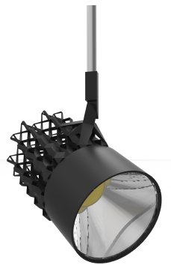
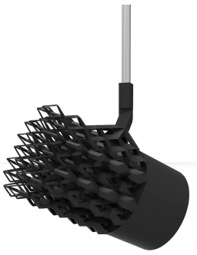
Success stories within heat transfer and fluid flow
Topology optimisation of passive coolers
for LED lamps (1264)
Optimization of the gas injector shape (1352)
Aalborg University, Denmark
10
Department of Mechanical and Manufacturing Engineering

Slide 11
Success stories within renewable energy
8 presentations within wind energy with the following subtopics:
RBDO of blades (1200)
Bearings (1287)
Jacket structures (1326, 1427)
Wind farm layout design (1330, 1347, 1389)
Wind turbine component design (1390)
3 papers within solar thermal power (1213, 1331, 1424)
Aalborg University, Denmark
11
Department of Mechanical and Manufacturing Engineering

Slide 12
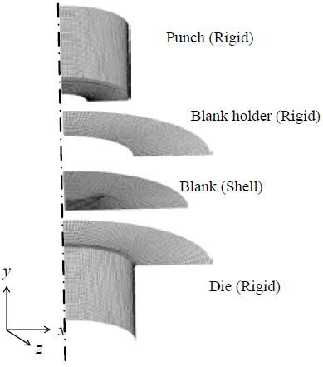
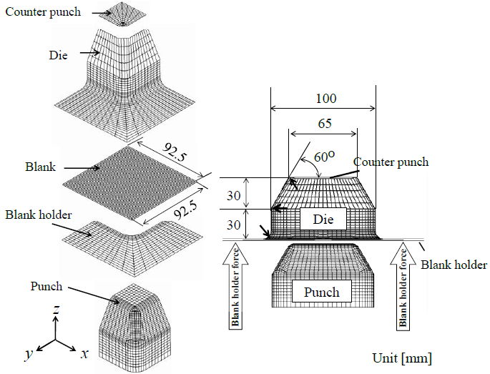
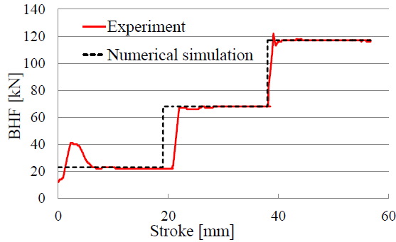
Success stories within process optimization
7 presentations within process optimization with the following subtopics:
Deep drawing (1102, 1375, 1391, 1409)
Cold rolling (1075)
Three-roll skew rolling (1122)
Injection moulding (1453)
Aalborg University, Denmark
12
Department of Mechanical and Manufacturing Engineering

Slide 13
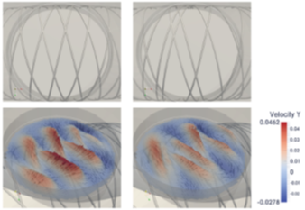
Success stories within health
7 presentations with the following subtopics:
Orthopedic prosthetic devices (1016)
Dentures (1028)
Stents (1110, 1456)
Fractal vasculature (1138)
Bone tissue engineering (1459)
Drug molecular design (1452)
Aalborg University, Denmark
13
Department of Mechanical and Manufacturing Engineering

Slide 14
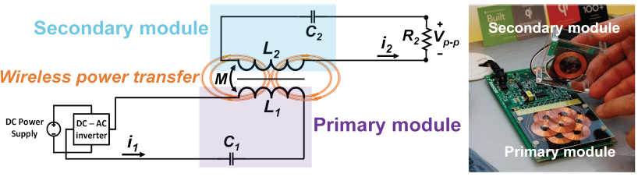
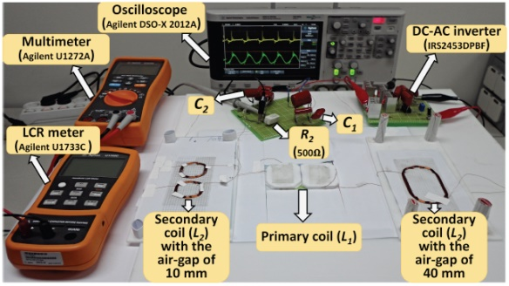
Success stories within control and electromagnetics
Optimal control strategies for valves in heat exchanger networks (1034)
Electromagnetic levitation coil design (1307)
Wireless power transfer (1097)
Aalborg University, Denmark
14
Department of Mechanical and Manufacturing Engineering

Slide 15
Observations and emerging opportunities
Aircraft and automotive are major targets for structural optimization.
Very many presentations of topology optimization methods while quite few on shape optimization methods.
Very few presentations (5 papers?) on shape optimization based on IGA (isogeometric analysis). Hot topic on computational mechanics conferences. Should be emerging field.
Very little MDO (less than 8 papers with focus on methods for MDO?). Is that only because the 16th AIAA/ISSMO Multidisciplinary Analysis and Optimization Conference is held very close to WCSMO-11 (on 22–26 June 2015)?
Much fewer presentations of optimization algorithms (mathematical programming) than seen on previous WCSMO congresses (6 papers?).
Aalborg University, Denmark
15
Department of Mechanical and Manufacturing Engineering

Slide 16
Observations and emerging opportunities
Mature level of handling multi-physics problems – very many opportunities in these directions for solving real life problems.
A slight increase in other physics than structural problems compared to WCSMO-10 – very many opportunities.
Additive manufacturing: mentioned in many presentations but not really exploited yet. Huge potential!
Integration of manufacturing rules/simulations in the design optimization loop. This could highly increase the impact of design optimization for real life applications.
Aalborg University, Denmark
16
Department of Mechanical and Manufacturing Engineering

Slide 17
Observations and emerging opportunities
Design of engineered materials (microstructure design / single- and multi-functional materials / metamaterials / multi-scale methods):
again: great potential in these areas, especially if manufacturing is taken into account.
ICT (Information and Communication Technologies ): more presentations here than at WCSMO-10 – many opportunities.
Health: many opportunities.
In general: very many emerging opportunities for our society ☺
Aalborg University, Denmark
17
Department of Mechanical and Manufacturing Engineering

Slide 18
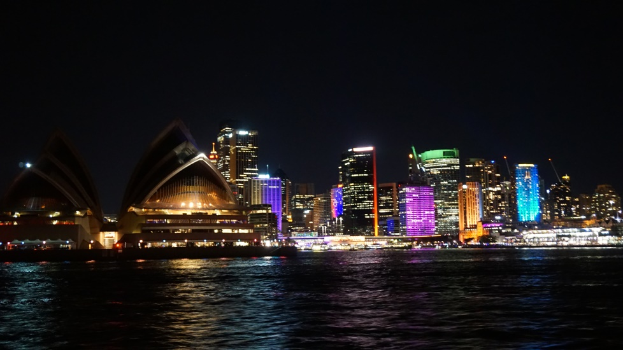
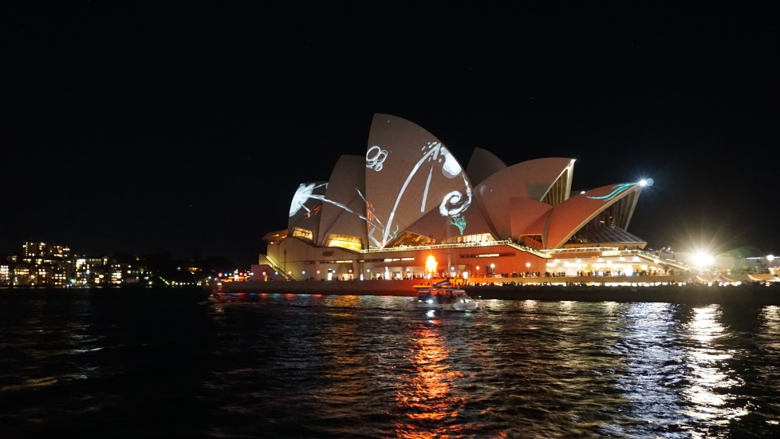


Thanks to the Local Organizers of WCSMO-11 for a well-organized and scientifically splendid congress together with a great social programme and atmosphere ☺
18

